Slide 1
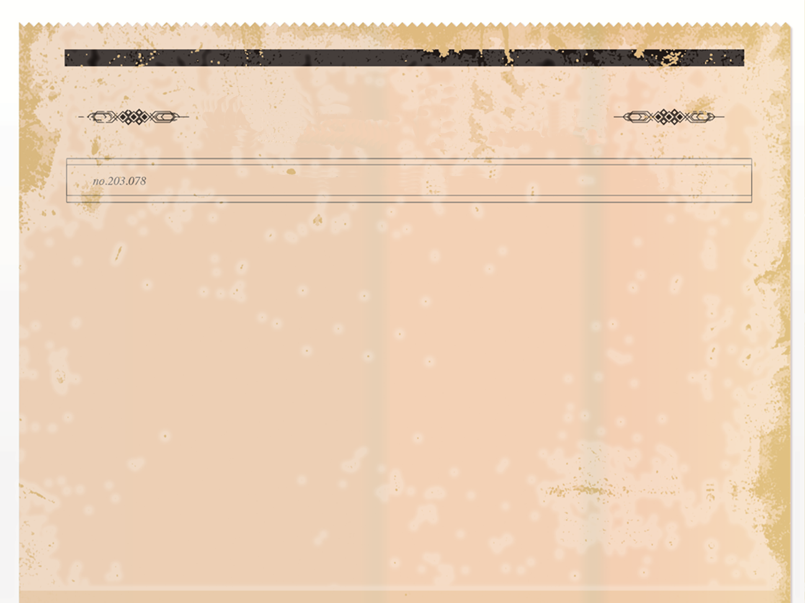
The Olden Times
THE WORLD’S OLDEST NEWSPAPER
- Since 1403
Group 11
Meagan Higgins Anna Truong Emma Dilley Sarah Brenis

Slide 2
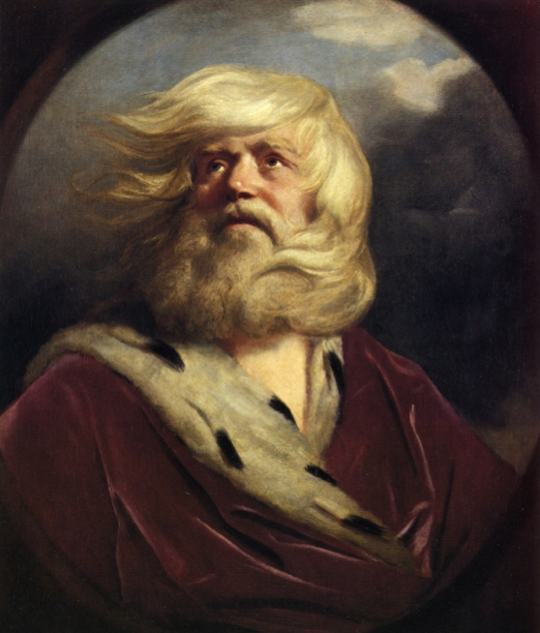
The Olden Times
THE WORLD’S OLDEST NEWSPAPER
- Since 1403
Obituaries
King Lear, 80
My dear master King Lear passed away on April 23rd, 1603. His death was not a surprise with his old age but he left many saddened, including myself, his loyal advisor and friend.
In his prime years, King Lear was a feared warlord, and he carried that demeanor with him until the end. Lear was respected by all, up until his daughters used his old age in their malicious favor. He was blinded by pride and couldn’t see that his youngest daughter Cordelia loved him more than any other.
In his last moments, King Lear was holding his beloved daughter in his arms, and, for a split second, he thought she was alive.
He died shortly after discovering this was not the case. He was aware of the mistake he had made, so he died knowing the truth. King Lear will be missed by many.
—Written by the Earl of Kent

Slide 3
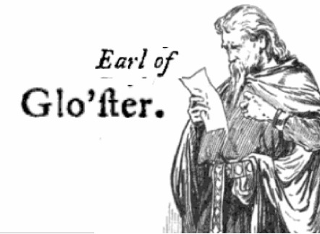
The Olden Times
THE WORLD’S OLDEST NEWSPAPER
- Since 1403
Obituaries
Gloucester, 66
My beloved father’s life was cut short. He was older, but it was not his time. My “brother” is to blame for this event. My father passed away due to heartbreak caused by my traitorous illegitimate brother’s elaborate plan. He fooled my father into believing that I was the mastermind behind his demise. I stood by my father through everything, but, in order to do so, I was forced to to disguise my true identity up until the very end.
I withheld him from taking his own life by jumping off the cliffs of Dover with a clever change of my voice. He was so tormented when he discovered the truth about his illegitimate son and his trickery that he singlehandedly blinded himself as punishment. He was a brave man and a led a great example of how a respected gentleman’s life should be led. —Written by Edgar

Slide 4
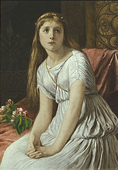
The Olden Times
THE WORLD’S OLDEST NEWSPAPER
- Since 1403
Obituaries
Cordelia, 26
Filial daughter Cordelia, best known for her refusal to profess her love to King Lear in return for 1/3 of the land has passed on the date of April 23rd, 1603. Though, I always knew her to be most truthful—more so than I can say for her other two sisters, Goneril and Regan. What scum! They treated my lord so terribly when all his Grace wanted was mere shelter from the storm.
By Zeus! If I were given powers, I would strike both
Goneril and Regan down with lightning for abandoning my master, King Lear!
But I digress… Back to the main purpose of my writing—our ever-faithful Cordelia! I’m saddened to inform that her cause of death was so merciless. To be hanged! What a cruel twist of fate. It is unjust for a righteous Lady to deserve such a thing! I blame her death on the lecherous Edmund for pressing the Captain to carry out such a derisive order.

Slide 5
The Olden Times
THE WORLD’S OLDEST NEWSPAPER
- Since 1403
Obituaries
Cordelia, 26
Who does he think he is? In my eyes he forever remains a base man! It is all thanks to him that our faithful Cordelia is no more. I am further saddened to say she is survived only by her husband, King of France who is heartbroken for his loss. She is missed by us all and her acts of devotion to her father shall live on forever.
—Written by the Earl of Kent

Slide 6
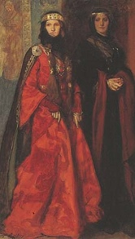
The Olden Times
THE WORLD’S OLDEST NEWSPAPER
- Since 1403
Obituaries
Regan, 35
Regan was born in the year 1568 to King Lear and his wife.
My dear Regan could accomplish anything she set her mind to. She was a strong, beautiful woman, who would use fake flattery, coerciveness, and cleverness, as long as it meant she got her way.
She fought for me like this and it made me feel so special and loved. These were my favorite qualities about her because they remind me so much of... me. We have many similarities, Regan and I.
For one, she has a nasty sibling, just as I do. She knew what she wanted and was willing to do anything to get it, just as I do. It really does seem like we were destined to be together, but I guess I must venture on without her.
My beautiful Regan spent some years married to the idiot duke of Cornwall before he died and she was left alone in this cruel world. I would have swept in and took her as mine right away if it weren’t for her all too jealous sister, Goneril. I desired her so and now she is gone because of that cruel,

Slide 7
The Olden Times
THE WORLD’S OLDEST NEWSPAPER
- Since 1403
Obituaries
Regan, 35
cold-hearted sister of hers.
Regan was not liked by many, but her power and reign has left its mark and this world will not be the same without her. I will miss her and mourn her loss for the rest of my life.
—Written by Edmund before his death Goneril, 36
My precious life has come to an end. My cleverness has failed me and I do not know how to get out of this predicament I led myself into.
My father hates me, my sister is dead, my husband has found out about my strong desire for Edmund, and Edmund has always shown more interest in that stupid sister of mine.
I have no reason to keep on. My life was filled with good times. I received power from my father just a couple weeks ago. I was a strong, powerful woman in this man-driven world. There was something special about me that no one seemed to understand, except Edmund. Even my husband Albany did not approve of the deeds I committed.

Slide 8
The Olden Times
THE WORLD’S OLDEST NEWSPAPER
- Since 1403
Obituaries
Goneril, 36
I can’t say I’m not proud of what I did, because I did it for the power. I hurt feelings, ruined lives, and killed my sister. I am a heartless witch and yet I feel no remorse. I had a plan and I was ready to do anything to achieve my goal. That is a great characteristic, is it not? My life has come to an end and I cannot go on any longer. Goodbye cruel world. —Written by Goneril herself before committing suicide

Slide 9
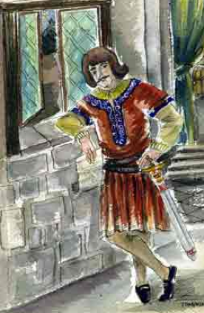
The Olden Times
THE WORLD’S OLDEST NEWSPAPER
- Since 1403
Obituaries
Edmund, 35
Edmund died after a single combat with his half-brother, Edgar. Edmund unfortunately suffered from a troubled past, which led him to make some flawed decisions in his lifetime. His father, Earl of Gloucester, had Edmund out of wedlock. Edmund struggled with the negative connotations and conversations centered around this fact. He was a very ambitious and persuasive man, but was misguided and followed the wrong people and ended up being loyal to the cruel Duke of Cornwall instead of his brother and father.
Edmund was a handsome man and had a way with the ladies, and was able to woo Goneril and Regan. In the last few moments of his life, Edmund had a change of heart and seemed to try to right at least one of his wrongs. He attempted to save the lives of King Lear and Cordelia, whom he had ordered to be executed.
—Written by Albany

Slide 10
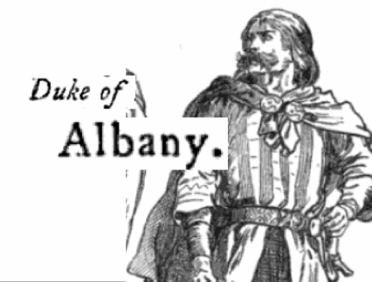
The Olden Times
THE WORLD’S OLDEST NEWSPAPER
- Since 1403
Duke of Albany
“In lieu of this horrible tragedy, we must always remember to do what is honorable and ensure that our actions remain noble. Let this be a lesson to those who come to rule in the future. You must always come to respect your family and leaders that have come before you.”—Duke of Albany

